Slide 1
Lists
Chris Walshaw
Computing & Information Systems
University of Greenwich

Slide 2
Lecture Objectives
The concept of lists
List methods, including
.sort(), .reverse(), .clear(), .append(), .insert(), .count(), .remove()
Library methods which can work with lists
len(), max(), min(), sum()
Indexing and slices

Slide 3
Motivation
As we saw last week many, many programs use loops to repeat the same operation over and over again, e.g.
a game updates the positions of all the characters many times per second
a cash point repeatedly takes customers through the same sequence of operations
Each time around the loop is likely to be working with different data
Lists are a way to store multiple values in a single variable
in other languages they are often called arrays
(Python does provide arrays too but they are not so common as lists)

Slide 4
Lists
Python uses square brackets, [ ], to denote lists
Lists can store Numbers, Booleans, Strings and other data types, e.g.
numbers = [0, 1, 2, 3]
truths = [False, True, False, True]
fruits = ["Banana", "Orange", "Apple", "Mango"]
In Python you can even mix different data types in the same list
but not in most programming languages
and not recommended!
https://www.w3schools.com/python/python_lists.asp

Slide 5
Accessing Lists
To access the value of a list item (either to read the value or update the value) we use the list index
the plural of index is indices
So, if fruits is a list, then fruits[2] is the item of the list with index 2
BUT … list indices are numbered from 0!!
so fruits[2] is actually the third item in the list fruits!
fruits[0] is the first item and fruits[1] is the second
This is not designed to be confusing – you will get used to it very quickly
in fact almost all programming languages number lists (arrays) from 0
Corresponds with the range() function giving us values starting at 0

Slide 6
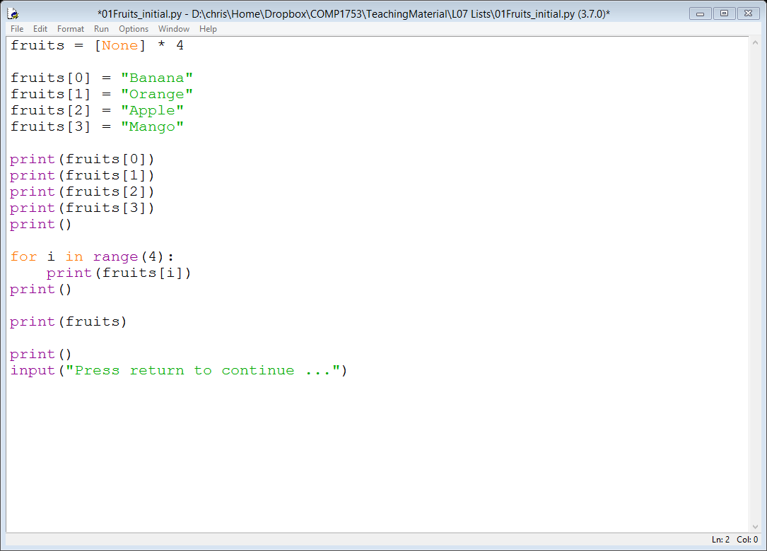
Initialising a list
The following line declares the list fruits and initialises it to have 4 values
We can fill in the values as follows

Slide 7
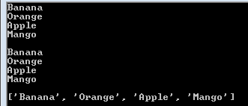
01Fruits_initial
Example 01 initialises the list fruits and prints out the contents in three different ways
by printing each item
using a loop which runs 4 times
by printing the list directly

Slide 8
Using loops and lists
A list usually has many items (possibly even thousands or millions)
A loop can repeatedly apply the same operation many times
So it makes sense to use loops (as in Example 01) to process lists
lists are the data counterpart of loops
almost all lists (or arrays in other languages) are processed using a loop

Slide 9
Problems
There are still two problems with Example 01
Firstly, the list items are inserted line by line
what happens if the programmer makes a mistake and types fruits[2] instead of fruits[3] – demo
Secondly, the loop always repeats 4 times regardless of how many items are in the list
what happens if the programmer deletes one or adds an extra one on the end – demo

Slide 10
The len() function
To fix the second problem we can use the list’s actual length rather than the fixed value 4
Python provides a built-in function called len() which returns the length of a list
So if fruits has 4 items the value of len(fruits) will be 4

Slide 11
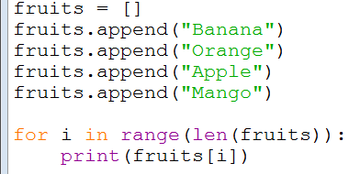
02Fruits_better
Example 02 fixes both of the previous problems
Here len(fruits) returns 4 and then we use range() to get the indices, 0, 1, 2, 3
Now if the programmer adds another fruit to the list, or deletes one of them, the code will still work fine - demo
the loop will run the same number of times as the list length

Slide 12
A better approach
In fact, if the list is relatively short and we know what the items are, we can declare and initialise in one line
the_list = ["item1", "item2", "item3", …]
We can also used an enhanced version of the for loop to process it
for item in the_list:
process item
This is a really common way of processing lists!

Slide 13
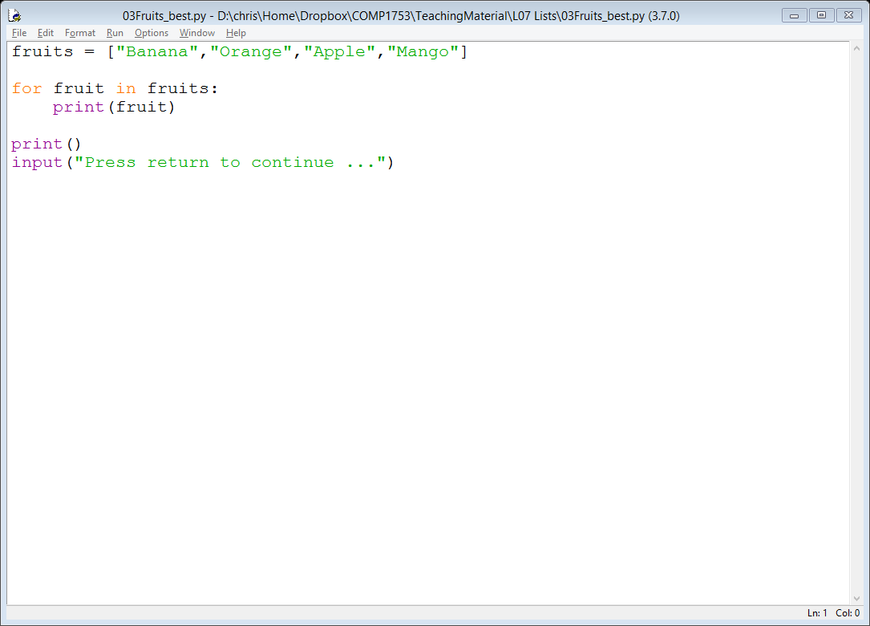
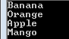
03Fruits_best
Example 03 demonstrates these ideas

Slide 14
Quick check
Given the following declaration
What value does fruits[2] have?
answer: Apple
What is the list index of Orange?
answer: 1
What value does fruits[4] have?
answer: there is no item with the index 4

Slide 15
The print_list() function
The next example wraps the list-printing loop in a function called print_list(), with some enhancements …
An optional header printed above the list
if no header is passed into the function, nothing is printed
Converts all list items to strings using str()
so the function can handle lists of numbers & booleans too
An extra print() call at the end to separate out the list from other output

Slide 16
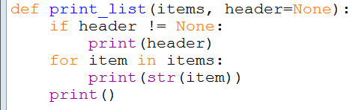
04Fruits_printFunction
Here is the print_list() function

Slide 17
List methods (functions)
As well as using len() to find out the length of an list, there are a number of functions that you can use to manipulate a list, e.g.
.sort() – to sort a list
.reverse() – to reverse the order of a list
.clear() – to clear (empty) a list
So the following code sorts and then reverses the order of the items in the list of fruits
fruits.sort();
fruits.reverse();
Because these functions are a part of the list data structure they are invoked using the . (dot) notation and are often known as list methods

Slide 18
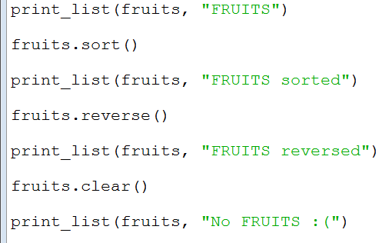
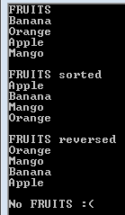
05Fruits_listMethods
Example 05 demonstrates list methods

Slide 19
List item methods
The list date structure also allows you to manipulate individual list items, e.g.
.append() – adds an extra item to the end of a list
.insert() – inserts an extra item at the specified position in a list
.count() – counts the number of items in the list with the specified value
.remove() – removes the first item with the specified value
Example 06 demonstrates the use of these methods

Slide 20
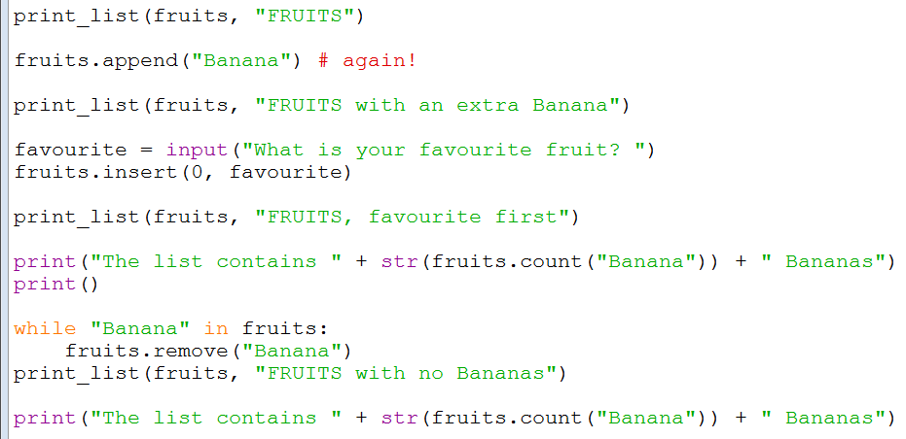
06Fruits_listItemMethods
Example 05 demonstrates item-based list methods

Slide 21
Lists of numbers
Of course we sometimes (often) want to work with numbers
And there may be additional requirements for the list, e.g.
sorted numerically
no duplicates (unique values only)
statistics (maximum value, minimum value, sum of all values, average value, etc)
The following random number examples demonstrate how to achieve these

Slide 22
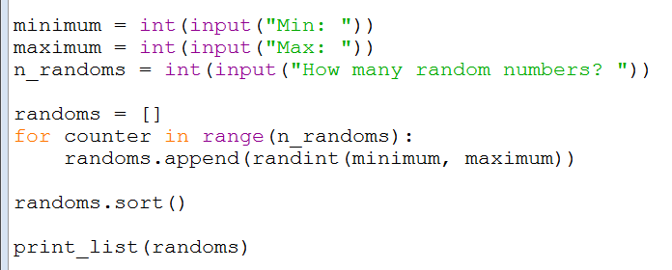
07Randoms_sorted
Example 07 is an updated version of the random values example with sorting
the random values are appended onto a list which is then sorted

Slide 23
Unique values
Suppose we want to make sure that random values are not duplicated (i.e. unique)
When we generate each value we need to check whether it has already been generated
We can do this easily using the in operator to check whether the list already contains the new value
only append the new value to the list if it’s not in the list

Slide 24
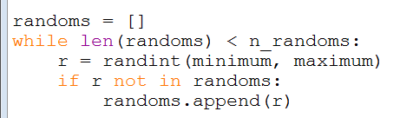
08Randoms_sortedUnique
Example 08 uses this idea to generate sorted unique random values

Slide 25
Sorted unique random values – notes
Notice the use of a while loop rather than a for loop
we don’t know how many times the loop will need to run
for example, if the user wants 6 random values but the code generates 3 duplicates in the process, the loop will run 9 times
If you get the settings wrong there could be problems
e.g. if min is set to 1 and max is set to 3, the only unique values are 1, 2 & 3, so if you ask for 4 random numbers the loop will never finish
This simple bit of code could be used to generate lottery numbers
7 unique numbers between 1 and 50

Slide 26
Sets
In computer science terms, a collection of unique values (i.e. with no duplicates) is usually called a set
In fact, Python also provides sets as a data structure
very similar to lists, in terms of usage, but use .add() rather than .append()
However … sets are unordered and there is no .sort() method available for sets
to sort the values in a set you have to copy them into a list first and sort that
https://www.w3schools.com/python/python_sets.asp

Slide 27
Using sets
Example 09 demonstrates this, but notice
we don’t need to check if the value already exists in the set – if it’s already there the .add() method does nothing
the print_list() function still works for a set, with no modifications!
for sorting, the values must be copied into a new list using the list() function ☹ - so we might as well use a list in the first place

Slide 28
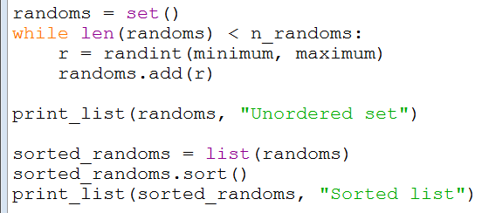
09Randoms_set
Here is the new version using sets, plus the code to convert back to a list

Slide 29
More list functions
There are various built-in functions we can apply to a list of numbers
max() – to find the maximum value
min() – to find the minimum value
sum() – to find the sum of all the values
there is no average function, but we can simply divide the sum() of the list by its length, given by len()

Slide 30
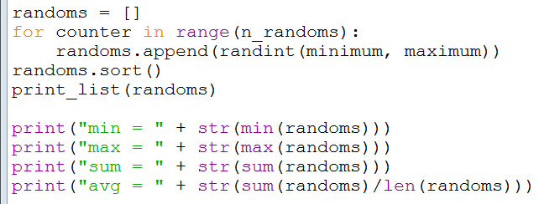
10Randoms_builtInFunctions
Example 10 demonstrates these using a list of non-unique randoms (like example 07)

Slide 31
Functions vs methods?
Notice the difference between the list methods and built-in functions
Methods, such as sort() and reverse(), are provided as part of the list data structure
they are invoked (called) using the . syntax on the list – e.g. randoms.sort(), randoms.reverse(), …
Built-in functions, such as len(), min(), max() and sum(), are provided as part of the Python library
they are invoked by passing the list in as a parameter – e.g. len(randoms), sum(randoms)
Strictly speaking, in Python all of them are functions, however the data structure functions are often referred methods
you will hear much more about methods next term

Slide 32
List indexing
So far we have seen that list[n] gives us the item of the list with index n
Sometimes we want to get items from the end of the list
we can do this using a negative list index
list[-1] returns the last item
list[-2] returns the next last item, etc
Sometimes we wish to use a portion of the list
we can do this by using the slicing functionality

Slide 33
Slicing
To get a portion of the list, use the format list[start:end:increment], where
start is the index of the first value
end is the index of the last value, plus 1
increment is the gap between each value
For example, if
numbers = [0, 1, 2, 3, 4, 5]
Then
numbers[1:3:1] returns a list containing the values [1, 2]
numbers[0:5:2] returns a list containing the values [0, 2, 4]

Slide 34
Slicing - defaults
The start, end and increment values can be left unspecified or even left out altogether
if :increment is left out, it defaults to 1
so list[start:end] is the same as list[start:end:1]
if increment is not specified, it defaults to 1
so list[start:end:] is the same as list[start:end:1]
if :end:increment is missing, they default to start+1 and 1 respectively
so list[start] is the same as list[start:start+1] which is the same as list[start:start+1:1]
if end is not specified, it defaults to the length of the list
so list[start::increment] is the same as list[start:len(list):increment]
if start is not specified, it defaults to 0
so list[:end:increment] is the same as list[0:end:increment]

Slide 35
Examples – single values
Can you predict the following when
letters = ["a", "b", "c", "d", "e", "f", "g"]
letters[1]
Answer: b
letters[-1]
Answer: g
letters[-3]
Answer: e
letters[-10]
Answer: an error

Slide 36
Examples – slices
Can you predict the following when
letters = ["a", "b", "c", "d", "e", "f", "g"]
letters[:1]
Answer: a (from 0, up to but not including 1)
letters[1:]
Answer: b, c, d, e, f, g (from 1, up to the end)
letters[:-1]
Answer: a, b, c, d, e, f (from 0, up to but not including last)
letters[-1:]
Answer: g (from last, up to the end)

Slide 37
Examples – more slices
letters[2:4]
Answer: c, d (from 2, up to but not including 4)
letters[5:100]
Answer: f, g (from 5, to beyond end of list – not an error)
letters[::2]
Answer: a, c, e, g (the whole list, with a gap of 2)
letters[1::2]
Answer: b, d, f (the whole list from 1, with a gap of 2)
letters[::-1]
Answer: g, f, e, d, c, b, a (the whole list going backwards)

Slide 38
List functions
How are min(), max() & sum() coded?
We will build our own versions to see how they work
A naïve version of min() might just sort the list and return the first entry, but there are problems with this approach – what?
the user might not want the list to be sorted!
sorting is a relatively slow operation (especially if the list contains millions of items)

Slide 39
Minimum
A better way is to record the smallest value encountered so far in a variable
then scan the list, updating the variable if something smaller is found
To start with, we can initialise the smallest value encountered as the first item in the list
smallest = items[0]
Then we can work through the rest of the list using a slice
for item in items[1:]:

Slide 40
Sum
Writing our own version of sum() is even easier
Set a variable, total, equal to zero
Run through the whole list, adding the value of each item in to the total

Slide 41
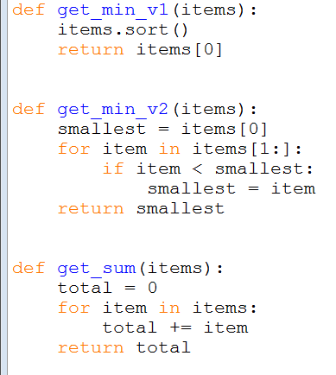
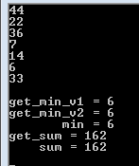
12Randoms_localFunctions
Example 12 shows the new functions, including the both versions of get_min()

Slide 42
Summary
Lists are a way to store multiple data values in a single variable
a fundamental data structure (the data counterpart to loops)
loops and lists are very often used together
List indices, e.g. [i], are used for accessing lists data
can use negative values, [-i]
can also use slices, [start:end:increment]
Looked at a number of list-based methods (there are others)
.sort(), .reverse(), .clear(), .append(), .insert(), .count(), .remove()
Also looked at library methods which can work with lists
len(), max(), min(), sum()

